Slide 1

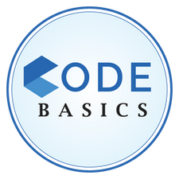

AtliQ Hospitality Analysis
Presented by –
Praveer Tiwari

Slide 2

Problem Statement
AtliQ Grands proudly owns a collection of five hotels in the major Indian cities such as Delhi, Mumbai, Hyderabad, Bangalore.
"AtliQ Grands, a well-established player in India's hotel industry, is facing tough competition and declining revenue in the luxury and business hotel sector. This is because of poor decisions and strong competitors. To fix this, their management team has decided to use data and smart strategies. They don't have their own data experts, so they are hiring an outside company to help them make better decisions and win back customers and money."

Slide 3

Dataset Details
We are provided with 3 months booking details data of all the AtliQ hotels.
Dataset contains 5 excel files:
Dim_date
Dim_hotels
Dim_rooms
Fact_aggregated_bookings
Fact_bookings
Metric list excel file
Mock-up Dashboard

Slide 4
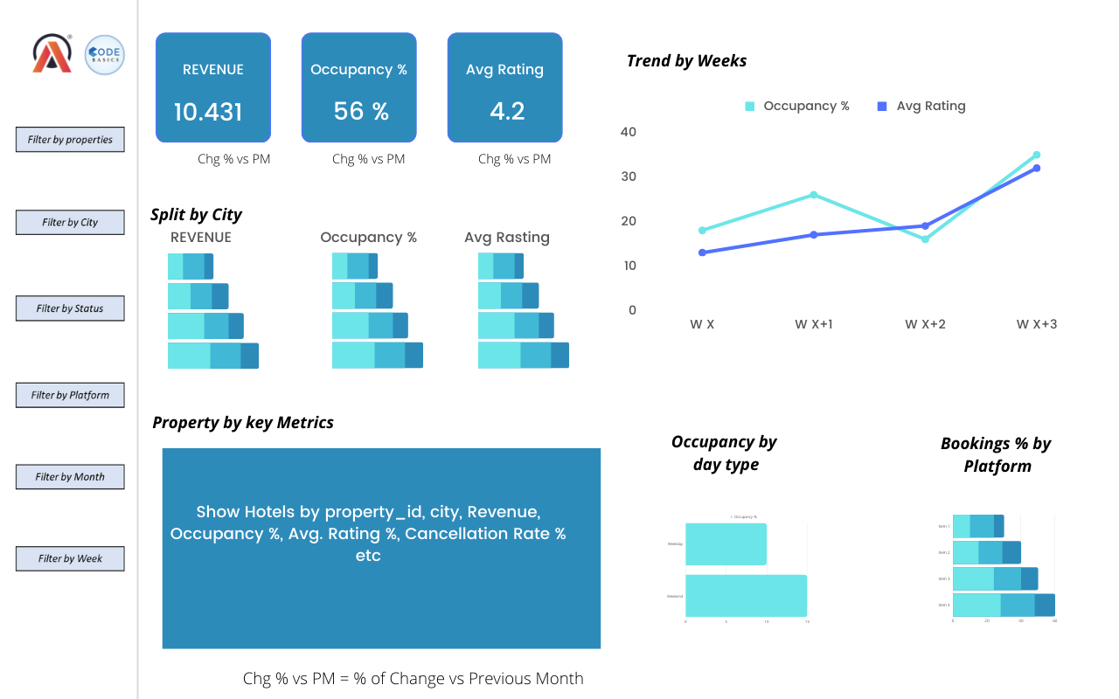

Mock-up Dashboard

Slide 5

Company Properties
AtliQ
Bangalore
Mumbai
Hyderabad
Delhi
Atliq Bay
Atliq Blu
Atliq City
Atliq Exotica
Atliq Grands
Atliq Palace
Atliq Bay
Atliq Blu
Atliq City
Atliq Exotica
Atliq Grands
Atliq Palace
Atliq Seasons
Atliq Bay
Atliq Blu
Atliq City
Atliq Exotica
Atliq Grands
Atliq Palace
Atliq Bay
Atliq Blu
Atliq City
Atliq Grands
Atliq Palace

Slide 6

Expected outcome after this analysis?
Regain their market share in the luxury/business hotels category.
Understanding the revenue trend by week/month//day
To get insights where business is failing and what can be done to tackle them.

Slide 7
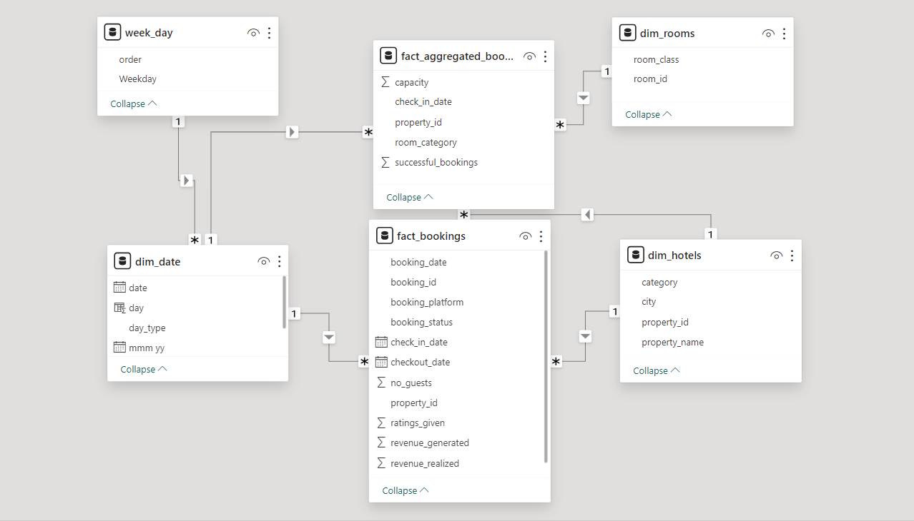

Data Model

Slide 8
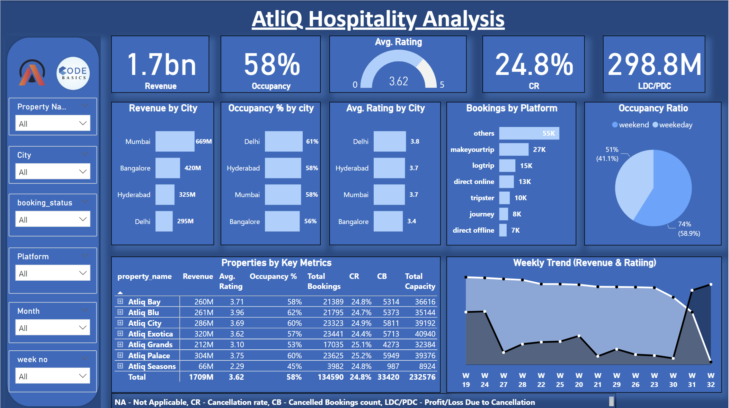

Dashboard

Slide 9

Major Insights
Mumbai generates the highest revenue (669 M) followed by Bangalore, Hyderabad and Delhi
AtliQ Exotica performs better compared to all 7 type of properties with 320 Million revenue, rating 3.62, occupancy percentage 57 and cancellation rate as 24.4%.
AtliQ Bay has the highest occupancy of 66%
Week 24 recorded the highest revenue among all, which is 139.6 Million
Delhi tops both in occupancy and rating followed by Hyderabad, Mumbai, Bangalore
AtliQ lost around 298 Million in cancellation
Elite type rooms has the most booking and as well higher cancellation rate

Slide 10

Thank You

